Slide 1
A penguin’s shadow
Light from a small bright lamp is shining on a screen.
A toy penguin is put half way between the lamp and the screen.
Screen

Slide 2
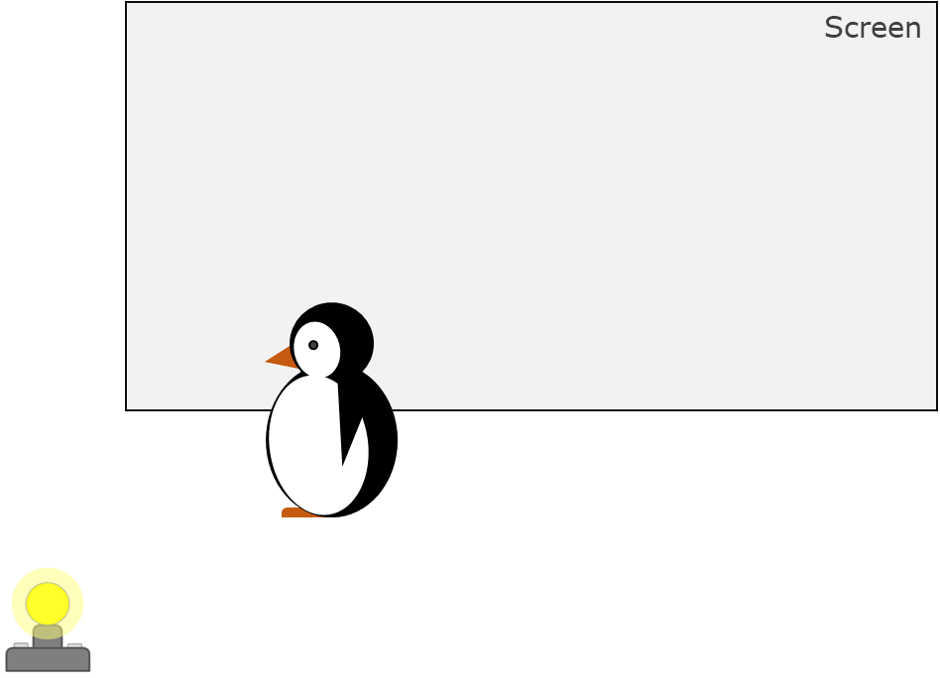
A penguin’s shadow
What would you see on the screen?
Full sized toy
A
B
C
D

